Slide 1

Department of Computer Science
University Institute of Engineering
DEPARTMENT OF COMPUTER SCIENCE & ENGINEERING
Bachelor of Engineering
Subject Name: System Programming
Subject Code: CST-315
Compilers
DISCOVER . LEARN . EMPOWER

Slide 2
Chapter 9
Operating System

Slide 3
Booting
Booting is basically the process of starting the computer. When the CPU is first switched on it has nothing inside the Memory.
In order to start the Computer, load the Operating System into the Main Memory and then Computer is ready to take commands from the User.
Booting may be defined as process of loading the operating system into memory.
The booting process starts from the moment when we power on computer and continues till moment, computer is ready for use.

Slide 4
Booting
What happens in the Process of Booting?
Booting happens when you start the computer.
This happens when we turned ON the power or the computer restarts.
The system BIOS (Basic Input/Output System) makes the peripheral devices active.
Further, it requires that the boot device loads the operating system into the main memory.

Slide 5
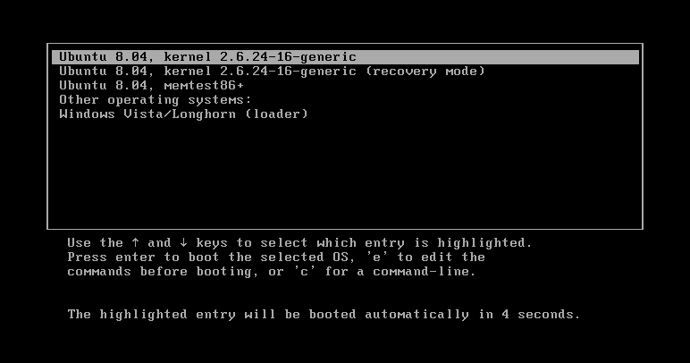
Booting

Slide 6
Booting
In the case of DOS, booting process starts when we start computer and continues till DOS prompt is displayed. The booting process of DOS mainly deals with loading three main system files of DOS into memory.
These files are IO.SYS, MSDOS.SYS and COMMAND.COM.

Slide 7
Booting
Boot Devices
Booting can be done either through hardware (pressing the start button) or by giving software commands.
Therefore, a boot device is a device that loads the operating system.
Moreover, it contains the instructions and files which start the computer.
Examples are the hard drive, floppy disk drive, CD drive, etc.
Among them, the hard drive is the most used one.

Slide 8
Booting
Types of Booting - There are two types of booting:
Cold Booting - A cold boot is also called a hard boot.
It is the process when we first start the computer. In other words, when the computer is started from its initial state by pressing the power button it is called cold boot.
The instructions are read from the ROM and the operating system is loaded in the main memory.

Slide 9
Booting
Warm Booting - Warm Boot is also called soft boot.
It refers to when we restart the computer.
Here, the computer does not start from the initial state.
When the system gets stuck sometimes it is required to restart it while it is ON.
Therefore, in this condition the warm boot takes place.
Restart button or CTRL+ALT+DELETE keys are used for warm boot.

Slide 10
Booting
Steps of Booting
We can describe the boot process in six steps:
1. The Startup - It is the first step that involves switching the power ON. It supplies electricity to the main components like BIOS and processor.
2. BIOS: Power On Self Test - It is an initial test performed by the BIOS. Further, this test performs an initial check on the input/output devices, computer’s main memory, disk drives, etc. Moreover, if any error occurs, the system produces a beep sound.

Slide 11
Booting
3. Loading of OS - In this step, the operating system is loaded into the main memory.
The operating system starts working and executes all the initial files and instructions.
4. System Configuration - In this step, the drivers are loaded into the main memory.
Drivers are programs that help in the functioning of the peripheral devices.

Slide 12
Booting
5. Loading System Utilities - System utilities are basic functioning programs, for example, volume control, antivirus, etc.
In this step, system utilities are loaded into the memory.
6. User Authentication - If any password has been set up in the computer system, the system checks for user authentication. O
nce the user enters the login Id and password correctly the system finally starts.

Slide 13
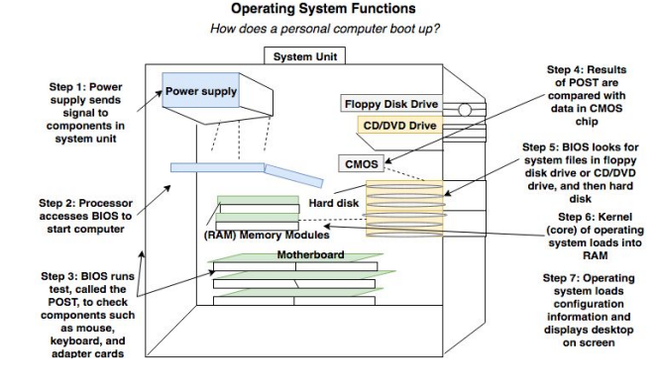
Booting

Slide 14
Frequently Asked Questions (FAQs)

Slide 15
Frequently Asked Questions (FAQs)
Q1. What is booting?
A1. The starting up of the computer is known as booting. It initiates all the devices before starting any work on the computer. Moreover, the operating system is loaded into the main memory.
Q2. What is BIOS?
A2. BIOS stands for Basic Input/Output System. It helps in the functioning of all the input/output devices. Further, it also helps to start and initiate the working of all devices during the boot process.
Q3. What are the boot devices?
A3. Boot devices are the devices that have the operating system loaded inside them during the boot process. Common devices are the hard drive, disk drive, floppy drive, etc.

Slide 16
Frequently Asked Questions (FAQs)
Q4. What are the types of booting?
A4. There are two types of the boot:
Cold Boot/Hard Boot
Warm Boot/Soft Boot
Q5. Why do we need booting?
A5. We perform this so that the operating system along with the initial files and instructions load into the main memory. And as a result, the computer starts.

Slide 17
Frequently Asked Questions (FAQs)
Q6. What are the basic steps of booting?
A6. Basic steps are:
The start-up
Power On Self Test
Loading OS
System Configuration
Loading system utilities
User authentication

Slide 18
Operating System

Slide 19
Essential Managers of Operating Systems
Essential Managers of Operating Systems
There are 5 main managers of operating systems:
Memory manager
Process manager
Device manager
File manager
Network manager
The network manager is a new addition to the operating system, previously all operating systems did not have networking capabilities and many still do not.
The Operating Systems manages the continuous monitoring of resources and enforcement of policies across the system.

Slide 20
Essential Managers of Operating Systems
1. Memory Manager
The Memory Manager is in charge of the main memory on the computer system.
Its tasks involve:
Preserves and protects the space in main memory that is occupied by the operating system
Checks validity of each request from memory space. Verifies whether or not a user request is valid.
For valid requests it allocates areas of memory not already in use for this.
In a multi user system it keeps track of which users are using which section of memory.
It deallocates sections of memory once they are finished with.

Slide 21
Essential Managers of Operating Systems
2. Processor Manager
Decides how to allocate the Central Processing Unit (CPU)
The tasks of a processor manager are:
Creates processes when necessary to carry out tasks
Performs initialization of new processes
Keeps track of the status of processes
Assigns processes to the CPU when available
Changes process states as events occur
Handles termination of proceses on completion or abort
Handles inter-process communication
Manages process queues and priorisation
Something to note is that a process is not the same as a program.

Slide 22
Essential Managers of Operating Systems
3. Device Manager
Monitors every device and control unit
The tasks of the device manager are:
Allocates systems devices
Deals with multiple requests for same device
Performs communication with the device during operation
Deallocates devices

Slide 23
Essential Managers of Operating Systems
4. File Manager
The File manager keeps track of every file in the system.
Its tasks are:
Organizes all files
Manages location of files
Enforces restrictions on files
Deals with standard file operations (delete, make new, etc)

Slide 24
Essential Managers of Operating Systems
5. Network Manager
Modern operating systems require a network manager.
The network manager allows users to share resources while controlling user access to them.
These resources can include hardware such as printers or disk drives or software such as files.

Slide 25
Essential Managers of Operating Systems
Interaction between OS and Managers
Each Operating Systems has specific individual tasks to perform but it is not enough for each to operate on its own.
Each manager must be able to work in harmony with the others at around the same time.
Example - A user types in a command at the keyboard to execute a program.
The following simplified steps might occur:
Device Manager: Receives keystrokes and builds up command line. Informs process manager that input has been received.

Slide 26
Essential Managers of Operating Systems
Device Manager: Receives keystrokes and builds up command line. Informs process manager that input has been received.
Processor Manager: Activates process awaiting a command. Process checks validity of command and then tries to execute the corresponding program.
File Manager: Checks to see if the program file is already in memory. If not, it finds it in external storage and issues requests for it.
Device Manager: Communicates with the disk drive and retrives the program file from disk.

Slide 27
Kernel in Operating System

Slide 28
Kernel in Operating System
Kernel is central component of an operating system that manages operations of computer and hardware.
It basically manages operations of memory and CPU time.
It is core component of an operating system.
Kernel acts as a bridge between applications and data processing performed at hardware level using inter-process communication and system calls.

Slide 29
Kernel in Operating System
Kernel loads first into memory when an operating system is loaded and remains into memory until operating system is shut down again.
It is responsible for various tasks such as disk management, task management, and memory management.
It decides which process should be allocated to processor to execute and which process should be kept in main memory to execute.

Slide 30
Kernel in Operating System
It basically acts as an interface between user applications and hardware.
The major aim of kernel is to manage communication between software i.e. user-level applications and hardware i.e., CPU and disk memory.

Slide 31
Kernel in Operating System
Objectives of Kernel :
To establish communication between user level application and hardware.
To decide state of incoming processes.
To control disk management.
To control memory management.
To control task management.

Slide 32
Kernel in Operating System
Types of Kernel :
1. Monolithic Kernel – It is one of types of kernel where all operating system services operate in kernel space.
It has dependencies between systems components.
It has huge lines of code which is complex.
Example - : Unix, Linux, Open VMS, XTS-400 etc.
Advantage : It has good performance.
Disadvantage : It has dependencies between system component and lines of code in millions.

Slide 33
Kernel in Operating System
2. Micro Kernel – It is kernel types which has simple approach.
It has virtual memory and thread scheduling.
It is more stable with less services in kernel space.
It puts rest in user space.
Example : Mach, L4, AmigaOS, Minix, K42 etc.
Advantage : It is more stable.
Disadvantage : There are lots of system calls and context switches.

Slide 34
Kernel in Operating System
3. Hybrid Kernel – It is the combination of both monolithic kernel and microkernel.
It has speed and design of monolithic kernel and modularity and stability of microkernel.
Example : Windows NT, Netware, BeOS etc.

Slide 35
Kernel in Operating System
4. Exo Kernel – It is the type of kernel which follows end-to-end principle.
It allocates physical resources to applications.
Example : Nemesis, ExOS etc.
Disadvantage : There is more work for application developers.

Slide 36
Kernel in Operating System
5. Nano Kernel – It is the type of kernel that offers hardware abstraction but without system services.
Example : EROS etc.
Advantage : It offers hardware abstractions without system services.
Disadvantage : It is quite same as Micro kernel hence it is less used.

Slide 37
Shell

Slide 38
Kernel in Operating System
What is Shell - A shell is special user program which provide an interface to user to use operating system services.
Shell accept human readable commands from user and convert them into something which kernel can understand.
It is a command language interpreter that execute commands read from input devices such as keyboards or from files.
The shell gets started when the user logs in or start the terminal.
Shell is broadly classified into two categories –
Command Line Shell
Graphical shell

Slide 39
Kernel in Operating System
Command Line Shell
Shell can be accessed by user using a command line interface.
A special program called Terminal in linux/macOS or Command Prompt in Windows OS is provided to type in the human readable commands such as “cat”, “ls” etc. and then it is being execute.
The result is then displayed on the terminal to the user.

Slide 40
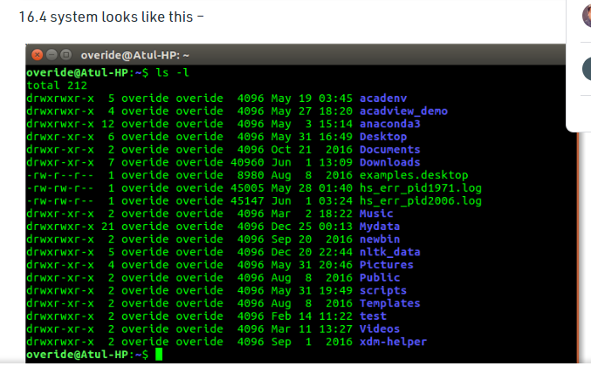
A terminal in Ubuntu 16.4 system looks like this

Slide 41
Kernel in Operating System
Graphical Shells
Graphical shells provide means for manipulating programs based on graphical user interface (GUI), by allowing for operations such as opening, closing, moving and resizing windows, as well as switching focus between windows.
Window OS or Ubuntu OS can be considered as good example which provide GUI to user for interacting with program.
User do not need to type in command for every actions.

Slide 42
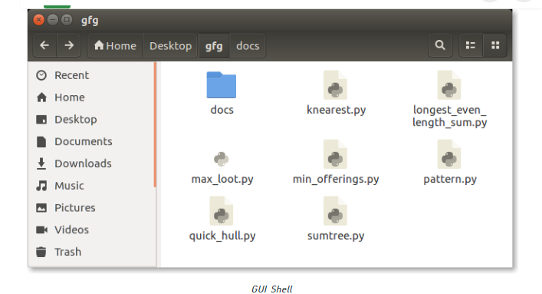
A typical GUI in Ubuntu system –

Slide 43
Shell
There are several shells are available for Linux systems like –
BASH (Bourne Again SHell) – It is most widely used shell in Linux systems. It is used as default login shell in Linux systems and in macOS.
It can also be installed on Windows OS.
CSH (C SHell) – The C shell’s syntax and usage are very similar to the C programming language.
KSH (Korn SHell) – The Korn Shell also was the base for the POSIX Shell standard specifications etc.
Each shell does the same job but understand different commands and provide different built in functions

Slide 44
Shell
Shell Scripting
Usually shells are interactive that mean, they accept command as input from users and execute them.
However some time we want to execute a bunch of commands routinely, so we have type in all commands each time in terminal.
As shell can also take commands as input from file we can write these commands in a file and can execute them in shell to avoid this repetitive work. T
hese files are called Shell Scripts or Shell Programs.
Shell scripts are similar to the batch file in MS-DOS. Each shell script is saved with .sh file extension eg. myscript.sh

Slide 45
Shell
Shell Scripting
A shell script have syntax just like any other programming language. If you have any prior experience with any programming language like Python, C/C++ etc. it would be very easy to get started with it.

